Slide 1
Recursive Support Vector Machine for Dimensionality Reduction
  Qing Tao, Dejun Chu, and Jue Wang
  IEEE TRANSACTIONS ON NERUAL NETWORK
  Vol. 19, NO. 1, January 2008
  Presenter: Chung Wei-Chun
  Date: April 2, 2008

Slide 2
Abstract (1/2)
The usual dimensionality reduction technique in supervised learning is mainly based on linear discriminant analysis (LDA), but it suffers from singularity or undersampled problems. On the other hand, a regular support vector machine (SVM) separates the data only in terms of one single direction of maximum margin, and the classification accuracy may be not good enough. In this letter, a recursive SVM (RSVM) is presented, in which several orthogonal directions that best separate the data with the maximum margin are obtained.

Slide 3
Abstract (2/2)‏
Theoretical analysis shows that a completely orthogonal basis can be derived in feature subspace spanned by the training samples and the margin is decreasing along the recursive components in linearly separable cases. As a result, a new dimensionality reduction technique based on multilevel maximum margin components and then a classiﬁer with high accuracy are achieved. Experiments in synthetic and several real data sets show that RSVM using multilevel maximum margin features can do efficient dimensionality reduction and outperform regular SVM in binary classification problems.

Slide 4
PCA vs LDA (1/3)
Principle Component Analysis
  an orthogonal transformation of the coordinate system in which we describe our data and the new coordinate values are called principal components.
Linear Discriminant Analysis
  aims to find the optimal discriminant vectors by maximizing the ratio of the between-class distance to the within-class distance, thus achieving the maximum class discrimination.

Slide 5
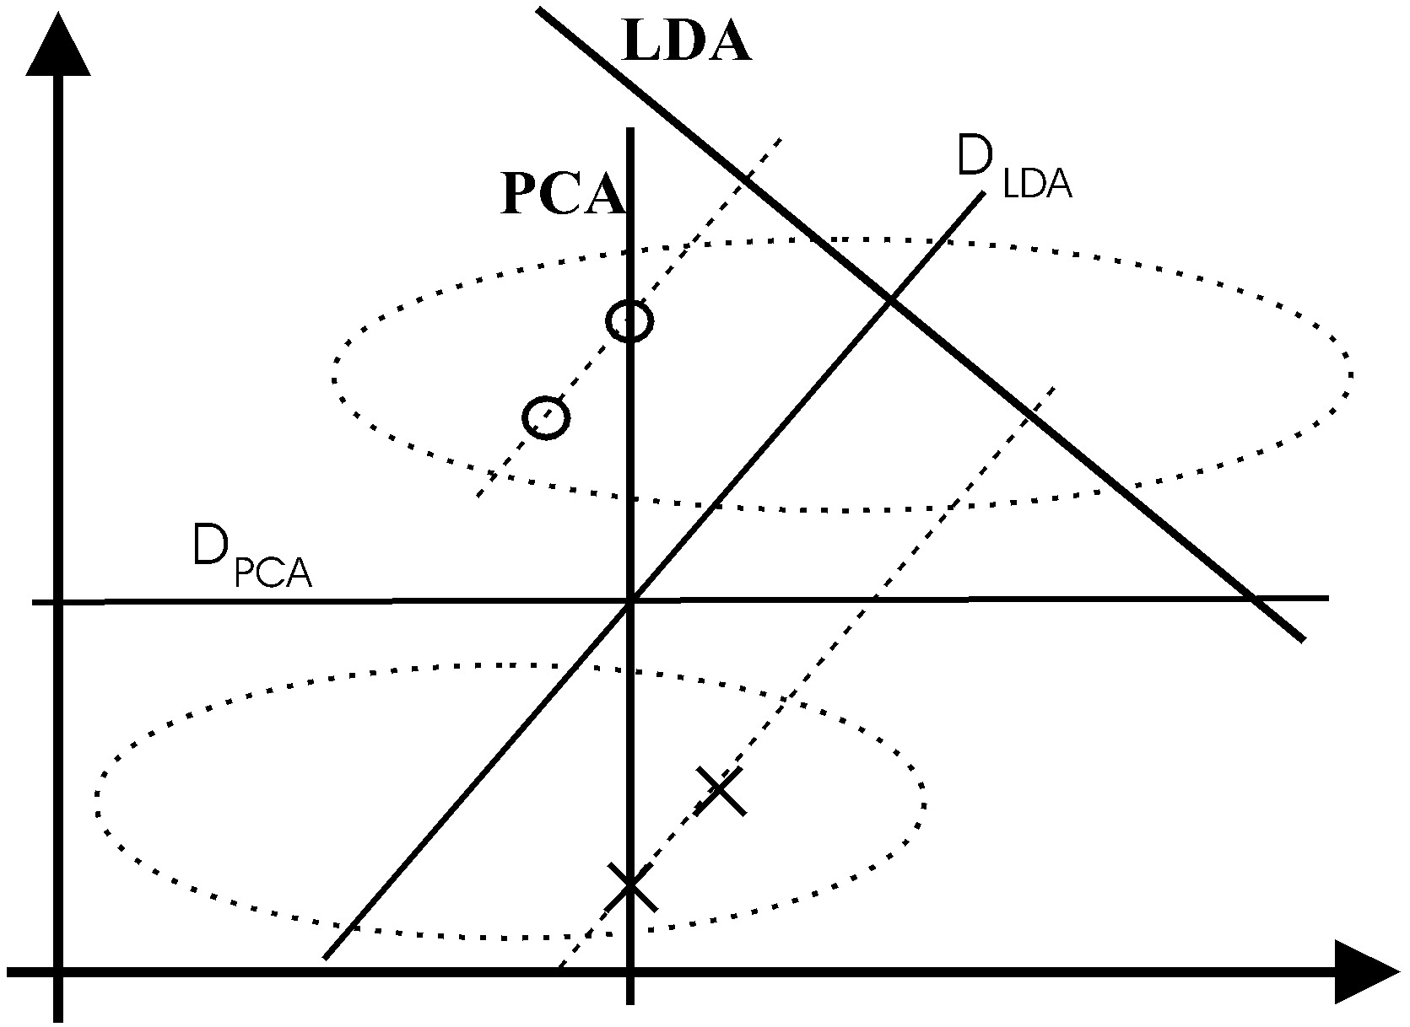
PCA vs LDA (2/3)‏

Slide 6
PCA vs LDA (3/3)‏
Efficiency: LDA>PCA
Problem: LDA requires the so-called total scatter matrix to be nonsingular.
  but all scatter matrices in question can be singular since the data points are from a very high-dimensional space and, in general, the sample size does not exceed this dimensionality.
  This is known as the singularity or undersampled problem.

Slide 7
Main idea
Recursively deriving new maximum margin features by discarding all the information represented by the old maximum margin features.

Slide 8
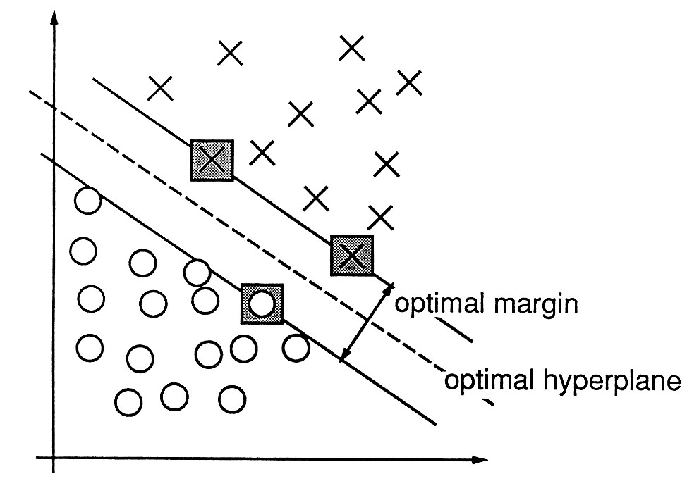
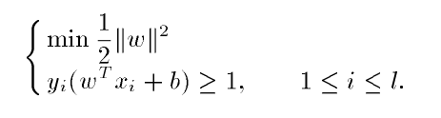
SVM

Slide 9
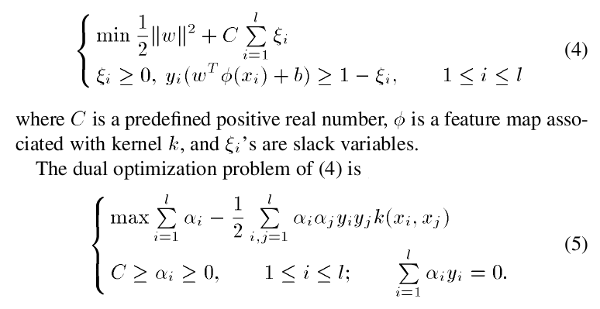
Dual optimization problem
Proved in C. Cortes and V. Vapnik, “Support vector networks,” Mach. Learn., vol. 20, pp. 273–297, 1995

Slide 10
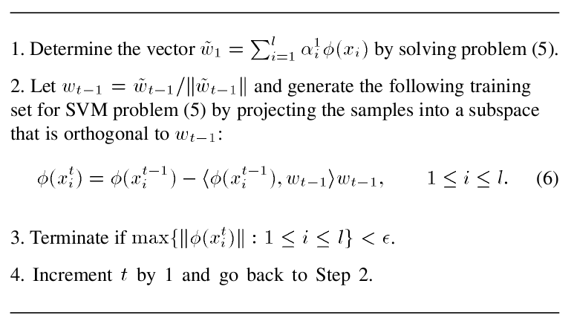
RSVM

Slide 11
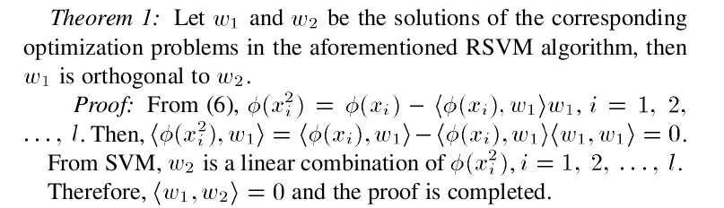
Theorem 1

Slide 12
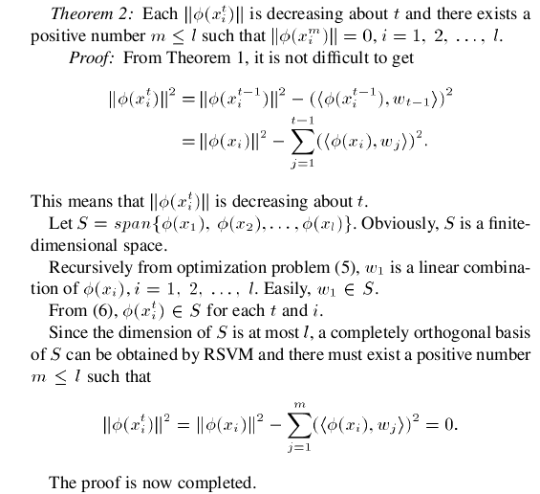
Theorem 2

Slide 13
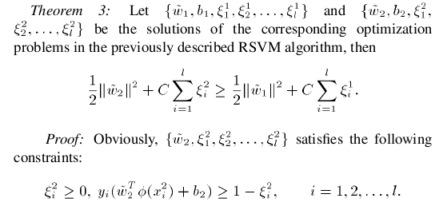
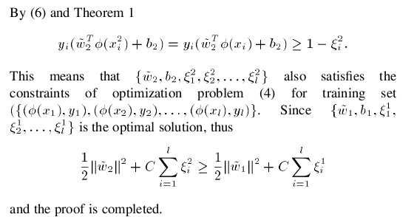
Theorem 3

Slide 14
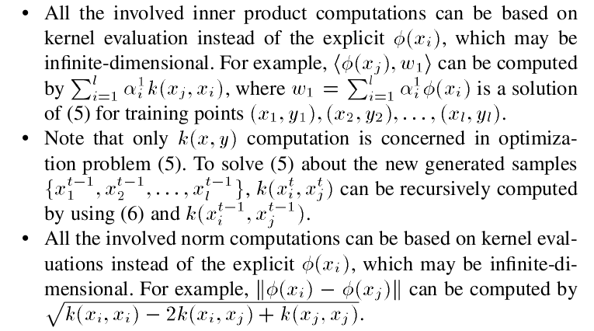
Remark

Slide 15
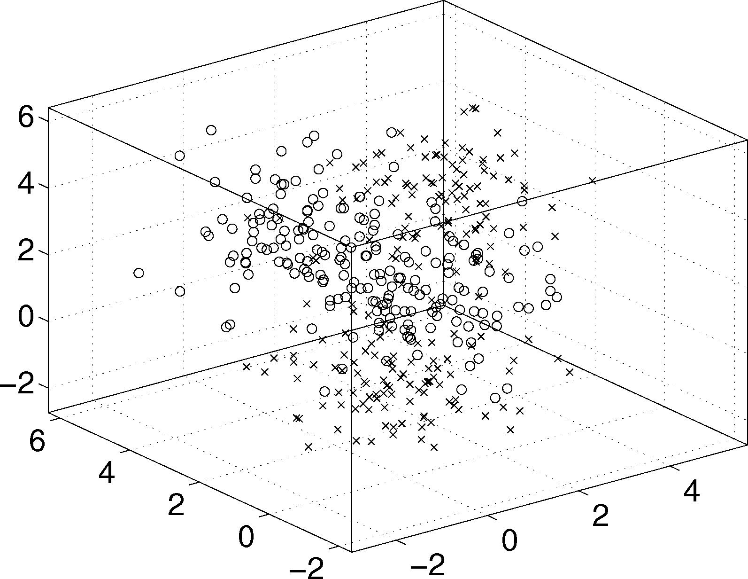
Experiment (1/6)
Toy data in 3-D space.

Slide 16
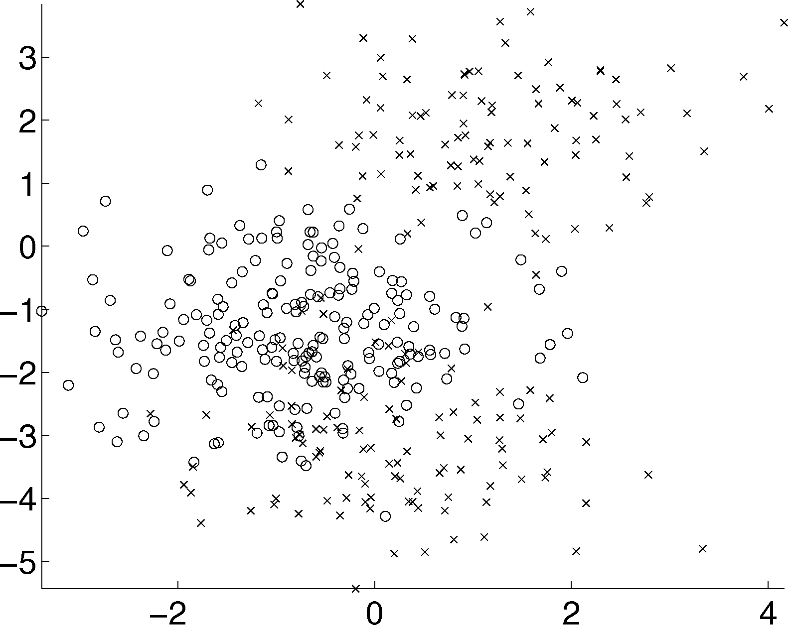
Experiment (2/6)
Projected data in 2-D space using linear RSVM with C = 11.

Slide 17
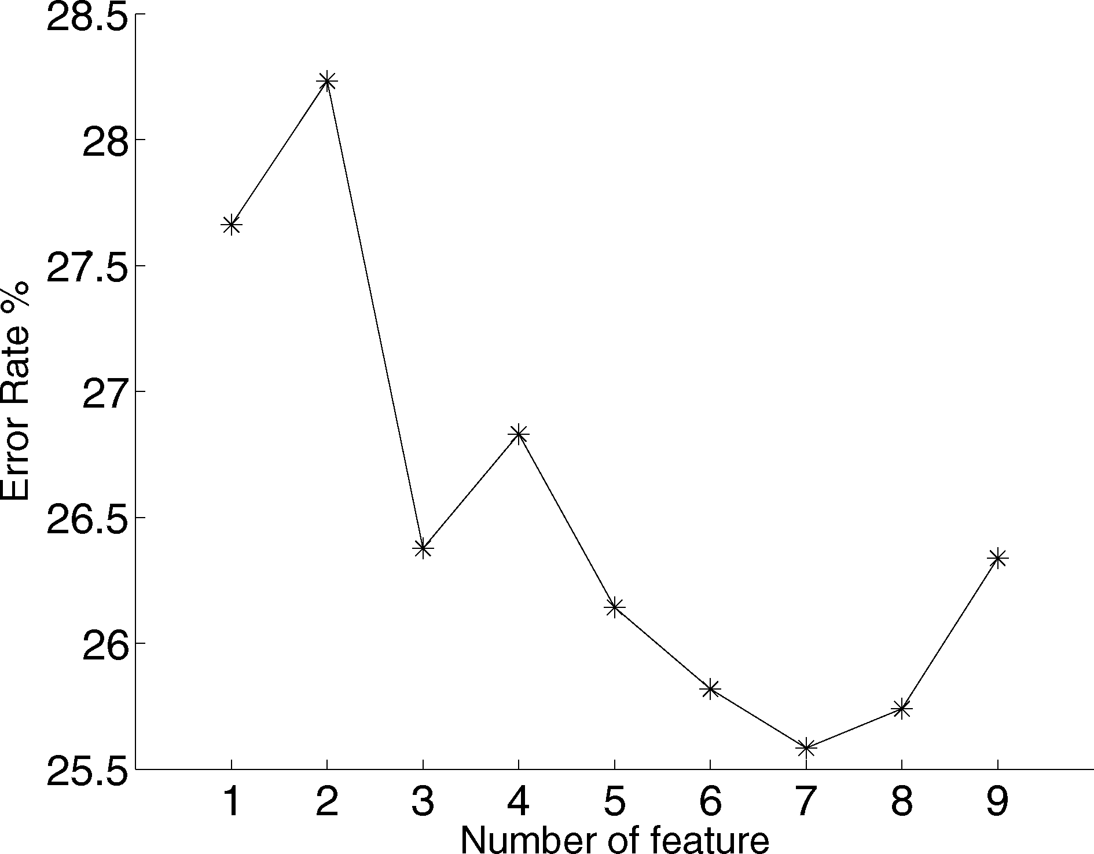
Experiment (3/6)
Relationship between the number of feature and classiﬁcation accuracy on breast cancer data set.

Slide 18
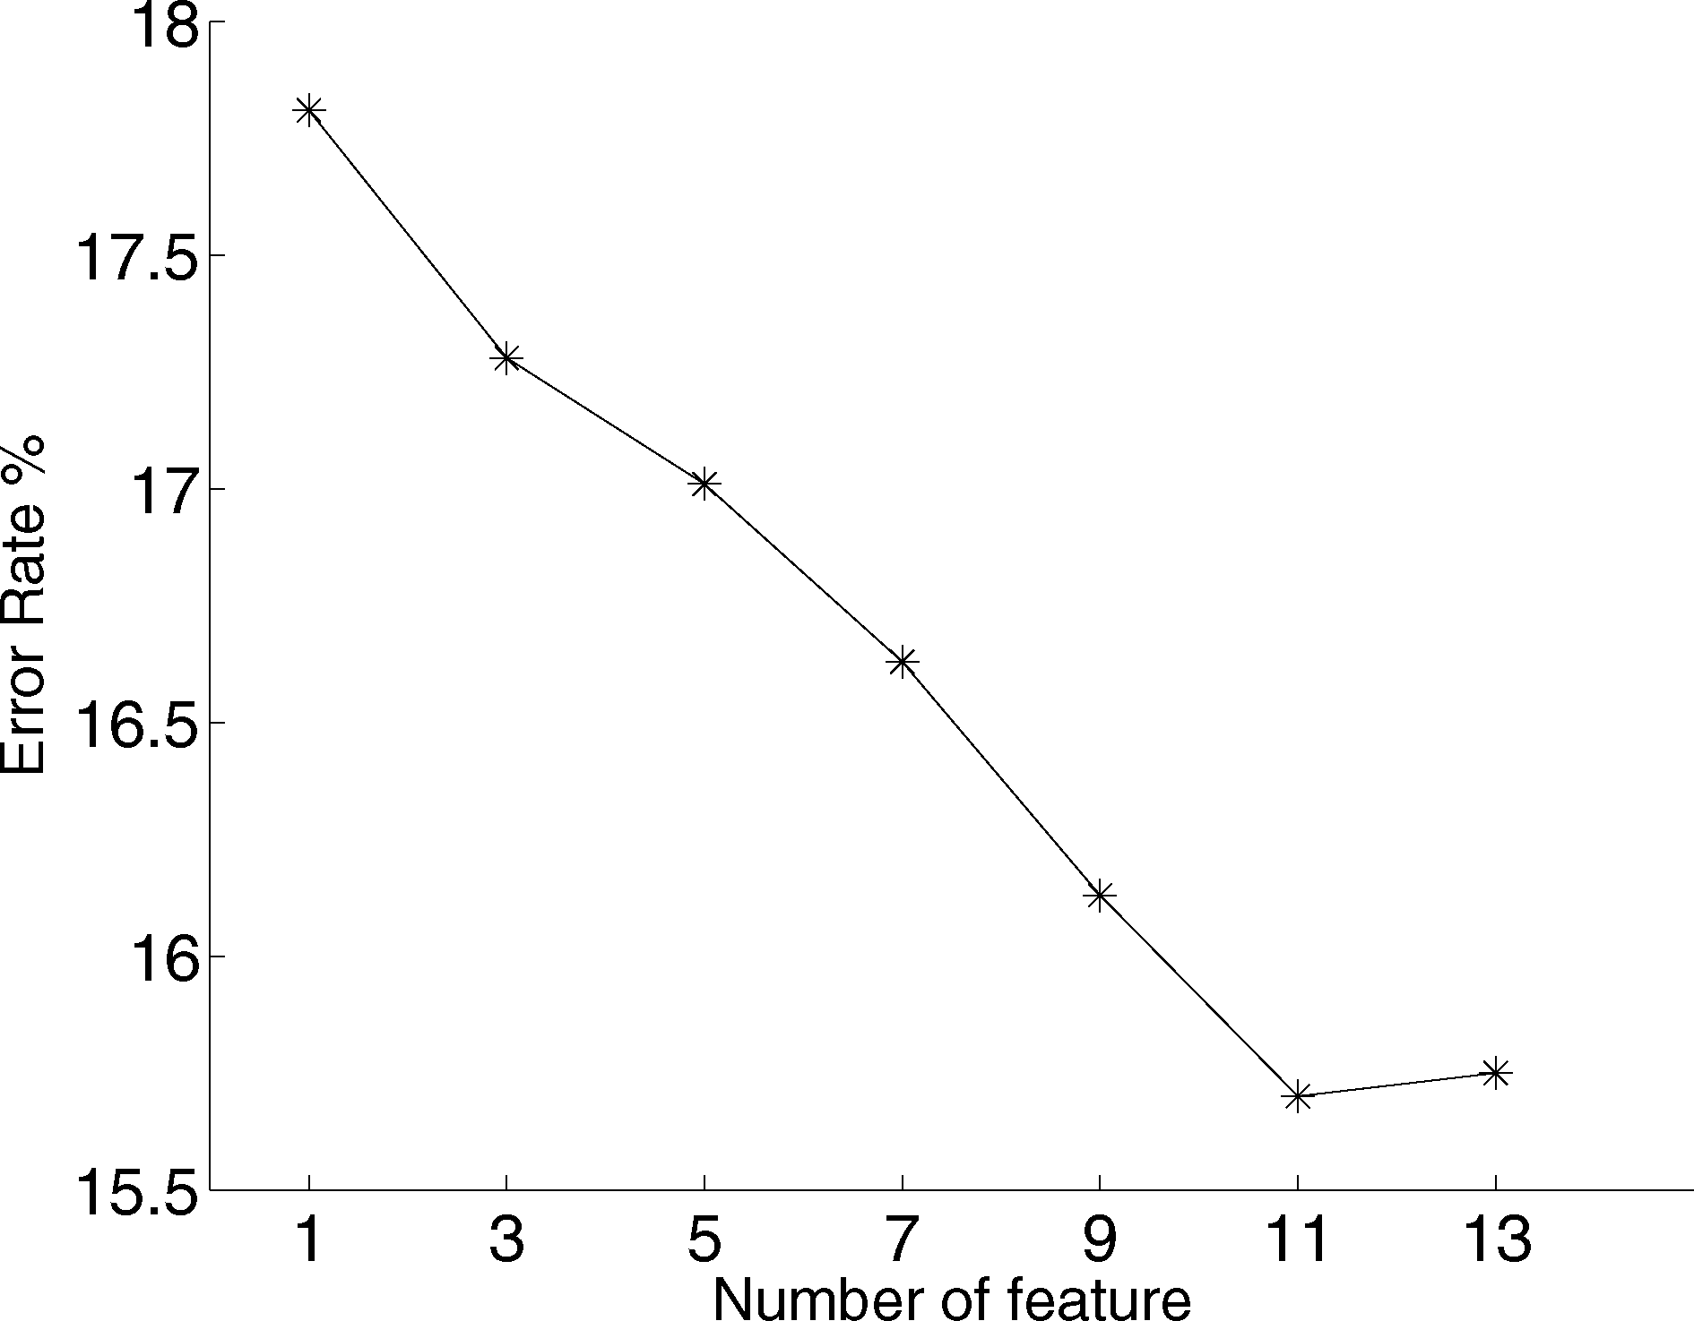
Experiment (4/6)
Relationship between the number of feature and classiﬁcation accuracy on heart data set.

Slide 19
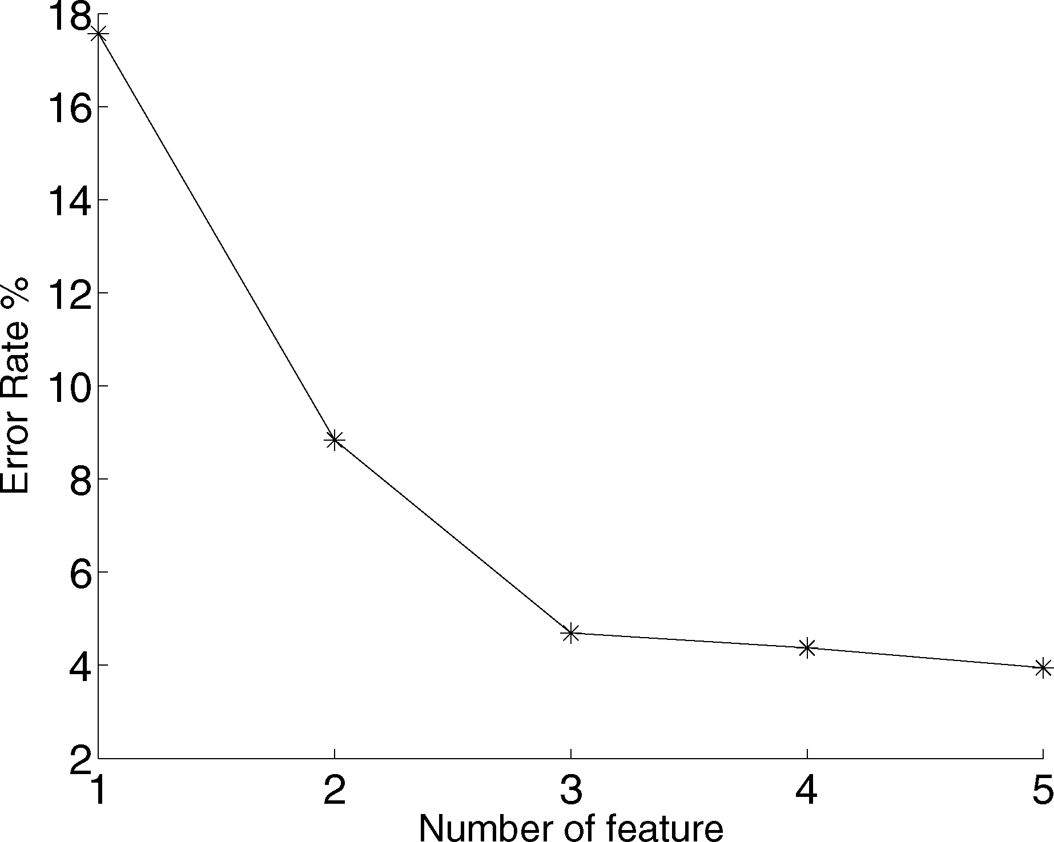
Experiment (5/6)
Relationship between the number of feature and classiﬁcation accuracy on thyroid data set.

Slide 20
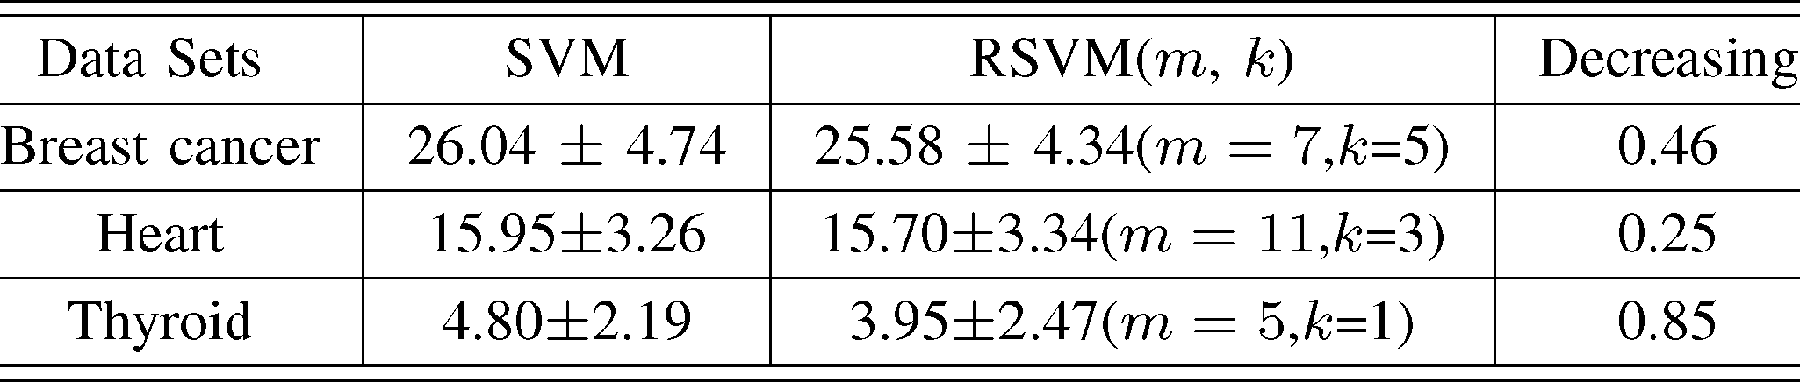
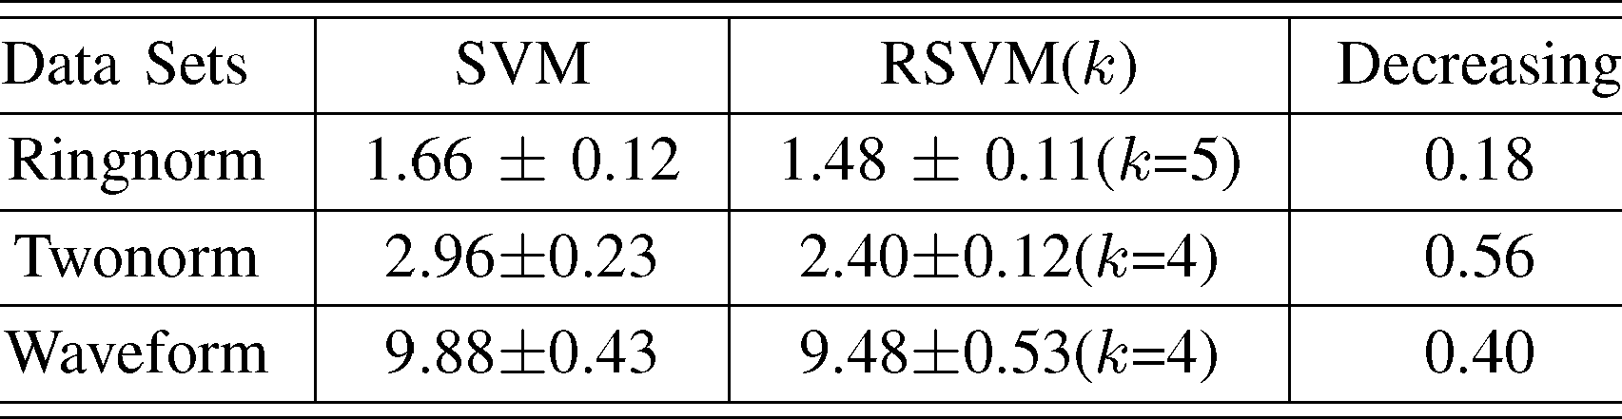
Experiment (6/6)
AVERAGE TEST ERRORS ERROR RATE WITH OPTIMAL DIMENSION
AVERAGE TEST ERRORS ERROR RATE (IN PERCENT) WITH ε=1e-6

Slide 21
Conclusion (1/2)
In this paper, a multidimensional maximum margin feature extraction approach for constructing a completely orthogonal basis and thus conducting efficient dimensionality reduction, called RSVM, is presented. Theoretical analysis shows that the SVM objective function is decreasing along the recursive components. In contrast to PCA, we use supervised information (labels) to conduct dimensionality reduction.

Slide 22
Conclusion (2/2)
Compared with LDA and regular SVM, the proposed method has no singularity problems and can further improve the accuracy. The general multilevel margin direction idea in this letter can be easily extended to SVM regression and several weighted SVM cases helping us to achieve more accurate results. Our future work will focus on using the recursive and multidimensional maximum margin idea to solve multiclassifcations, especially face recognition problems. it may be that a new representing and recognizing approach for face patterns can be expected.

